Slide 1
MRI AI
ALEXANDRU IFTIMIE

Slide 2
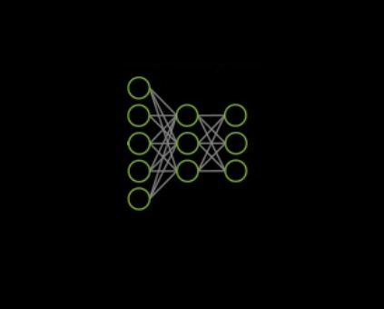
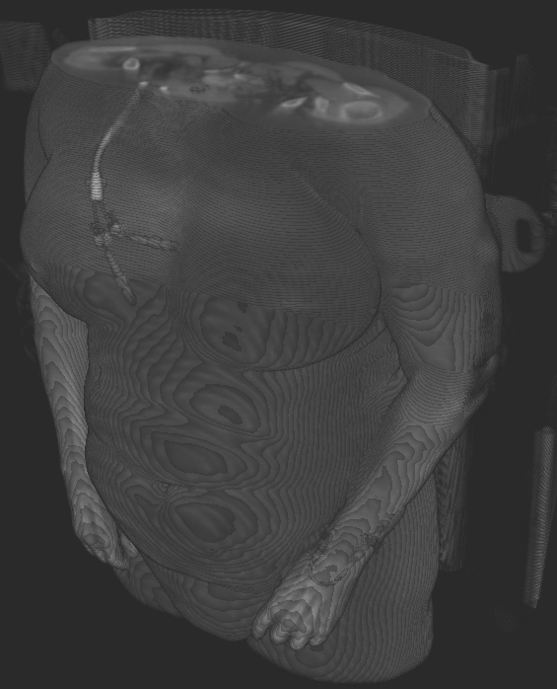
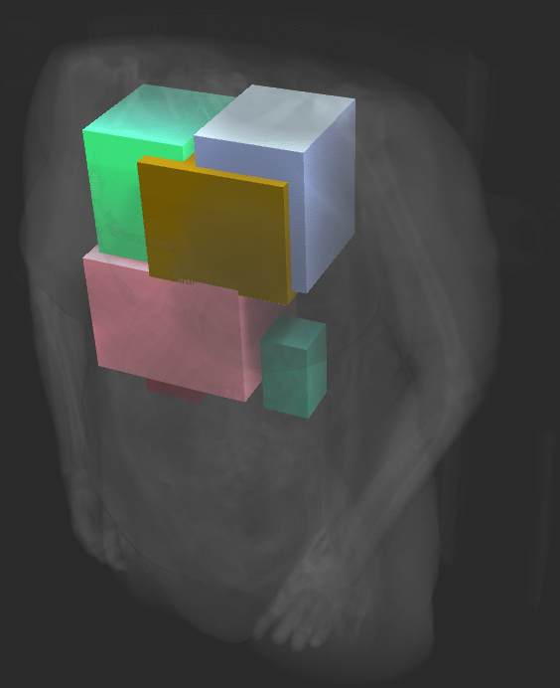
ABOUT THE PROJECT
Neural network model capable of predicting 3D bounding boxes for anatomical structures given a 3D volume from MRI scanner.

Slide 3

WHY RESEARCH THIS?
AI in medicine should be more popular (personal opinion)
We hear a lot about self-driving cars, robots, smart gadgets but no so much about the use cases of AI in medicine
Consolidating knowledge
Learned new deep learning frameworks and better understood the insights of object detection and other machine learning techniques.

Slide 4
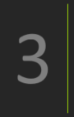
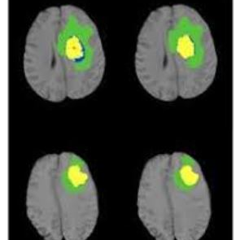
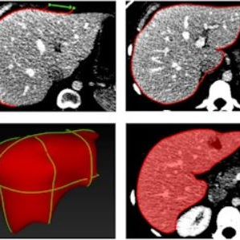
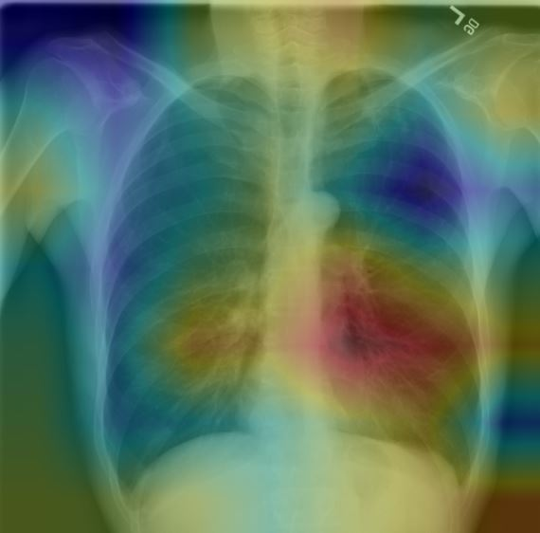
WHY RESEARCH THIS?
Possible missing component of a complete system
There are existing models that solve a specific task such as segmentation or classification but their use is limited to a Field of View which is specified by the practitioner. In this research I aim to eliminate human input. Everything should be done end to end.
Tumor segmentation
Liver segmentation
Pneumonia detection
Left is label
Right is NN segmentation
BRATS challenge
Volumetric analysis task
121 layer CNN: CheXNet

Slide 5
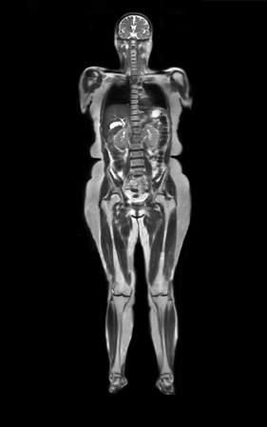
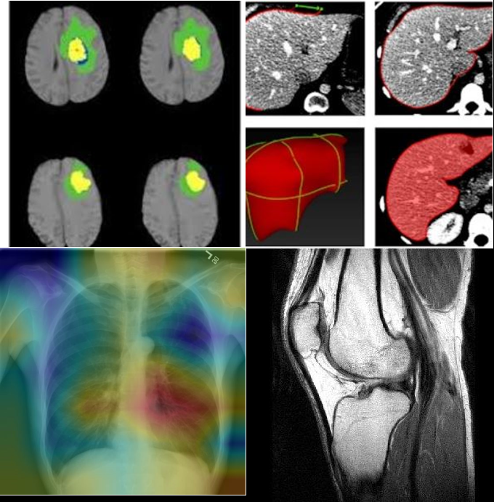
WHY RESEARCH THIS?
Possible missing component of a complete system
There are existing models that solve a specific task such as segmentation or classification but their use is limited to a Field of View which is specified by the practitioner. In this research I aim to eliminate human input. Everything should be done end to end.
Predict
organ locations
Reduced redundancy in computing specific task

Slide 6
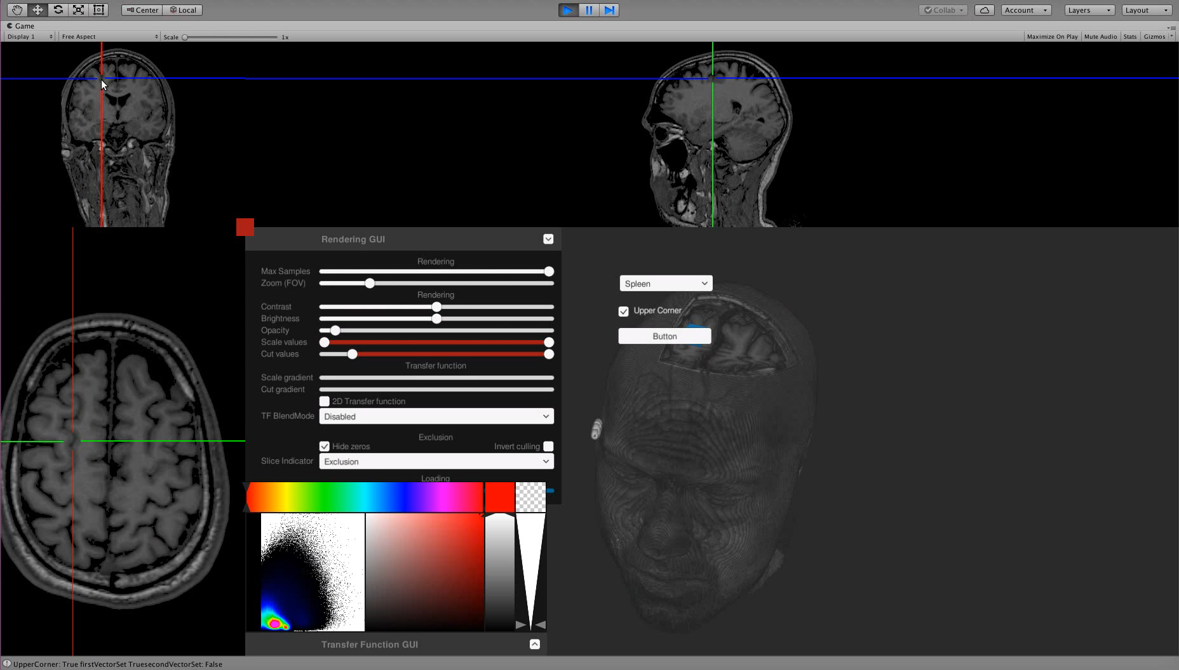
STEP 1
Create a visualization and annotation tool, then label some data. Public databases for this problem do not exist.
What We Have Looked At
Took existing visualization code and extended with marking options.
Used Unity engine
With the help of a medicine student we created a dataset of: - 5 marked volumes with 6 classes (very time consuming)
- 50 unlabeled volumes in the dataset

Slide 7
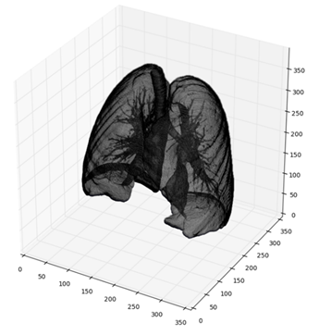
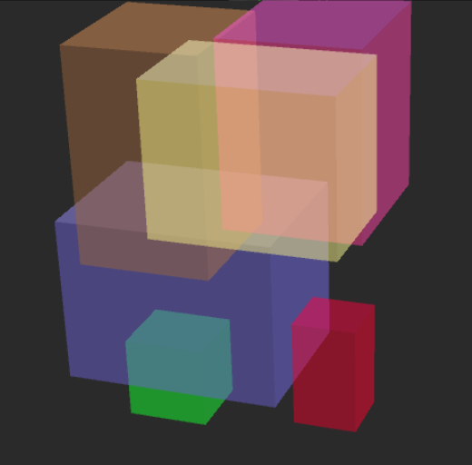
STEP 2
Started writing code for the neural network. This part of presentation will focus on the intuition behind the model.
Neural network (based on Faster-RCNN)
3D Input volume
Feature extraction part
Region proposal network
Classification network
Features
Proposals
Final predictions

Slide 8
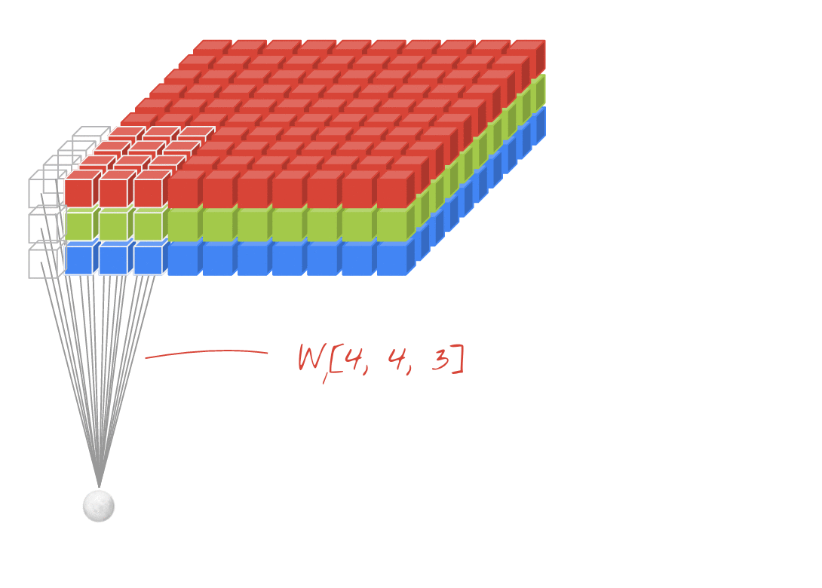
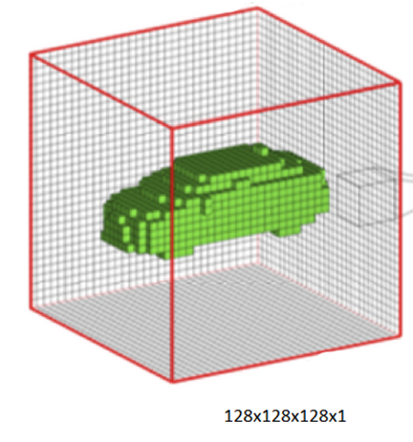
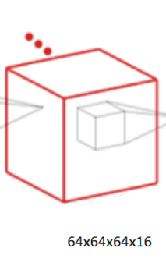
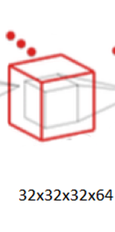
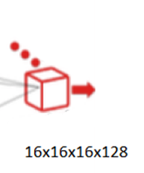
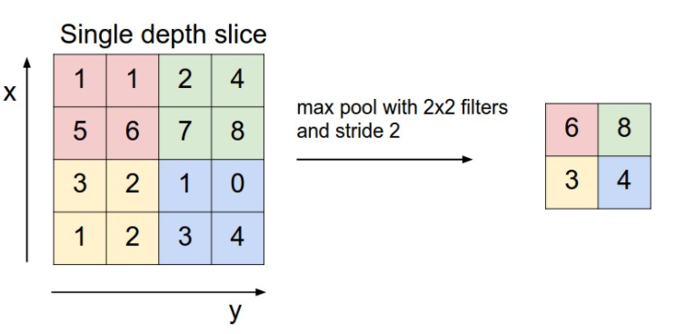
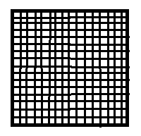
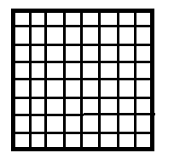
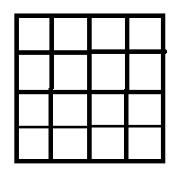

STEP 2
Started writing code for the neural network. This part of presentation will focus on the intuition behind the model.
Feature extraction part
Convolution
Features
Max pooling

Slide 9
STEP 2
Started writing code for the neural network. This part of presentation will focus on the intuition behind the model.
Neural network
3D Input volume
Feature extraction part
Region proposal network
Classification network
Features
Proposals
Final predictions

Slide 10
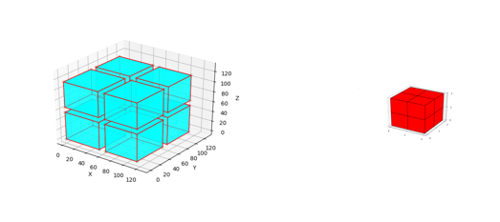
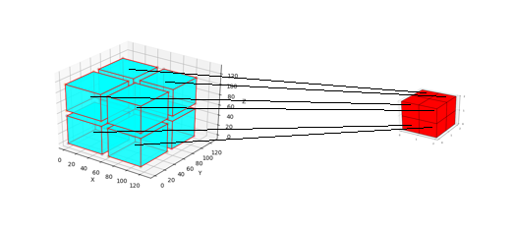
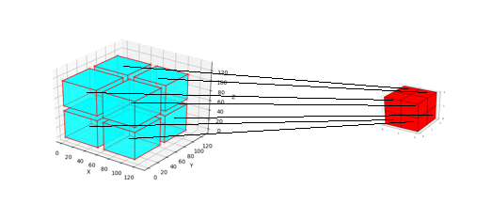
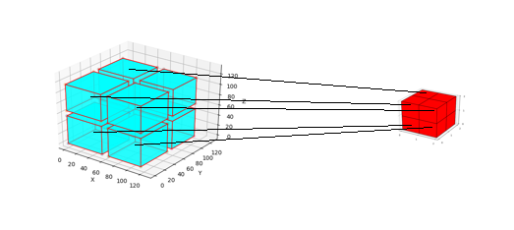
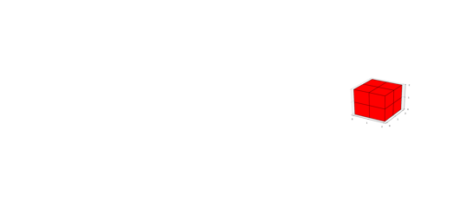
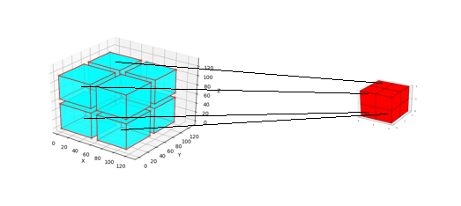

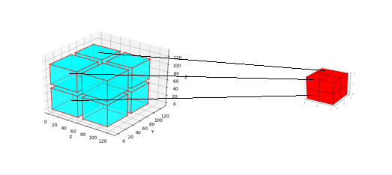
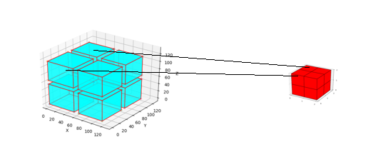
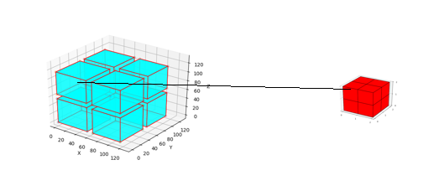
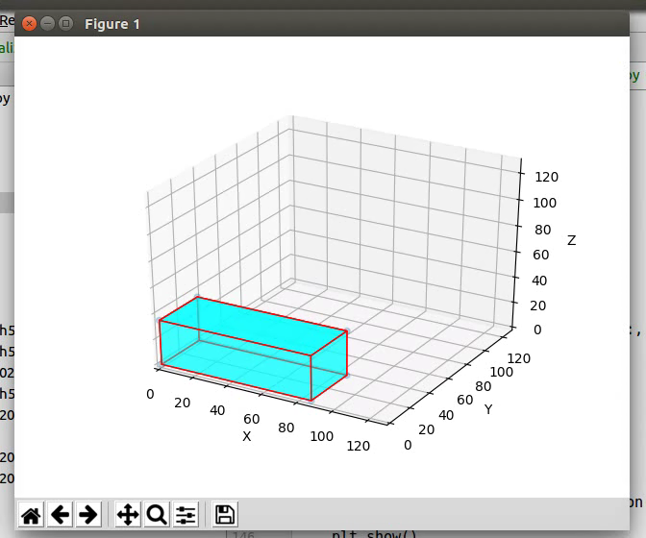
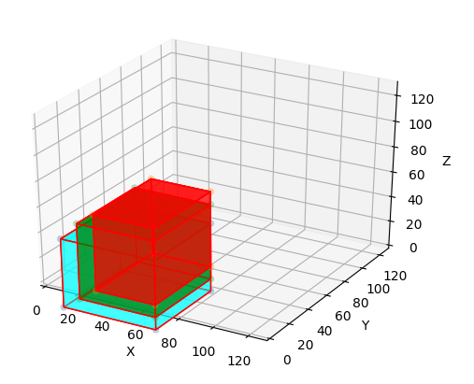
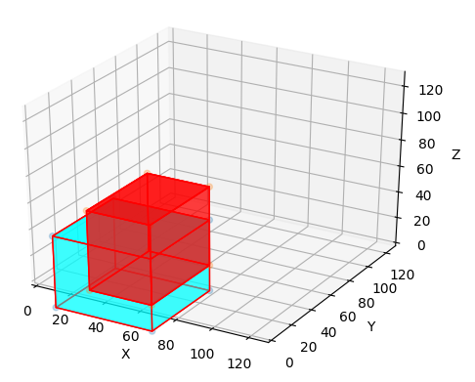
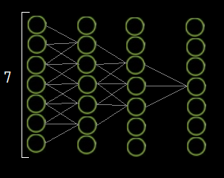
STEP 2
Started writing code for the neural network. This part of presentation will focus on the intuition behind the model.
Region proposal network
Input volume receptive fields for the following neurons
Final layer volume with 2x2x2x1 (the features)
Receptive field
If p(obj|anchor) < 0.7 -> discard
Proposals
For each kept anchor, shift them with a ∆ in order to fit the object better

Slide 11
STEP 2
Started writing code for the neural network. This part of presentation will focus on the intuition behind the model.
Neural network
3D Input volume
Feature extraction part
Region proposal network
Classification network
Features
Proposals
Final predictions

Slide 12
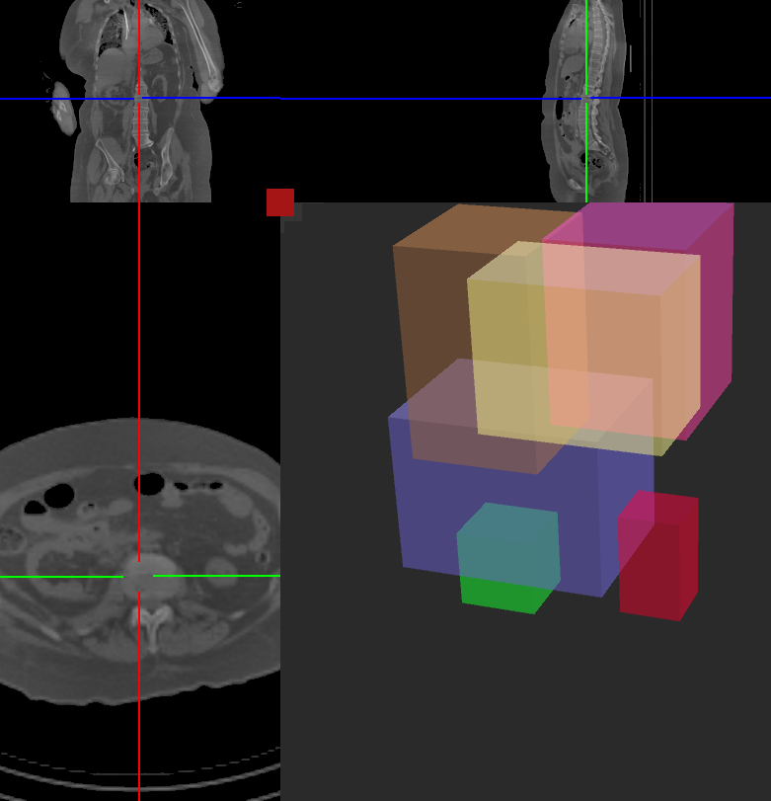
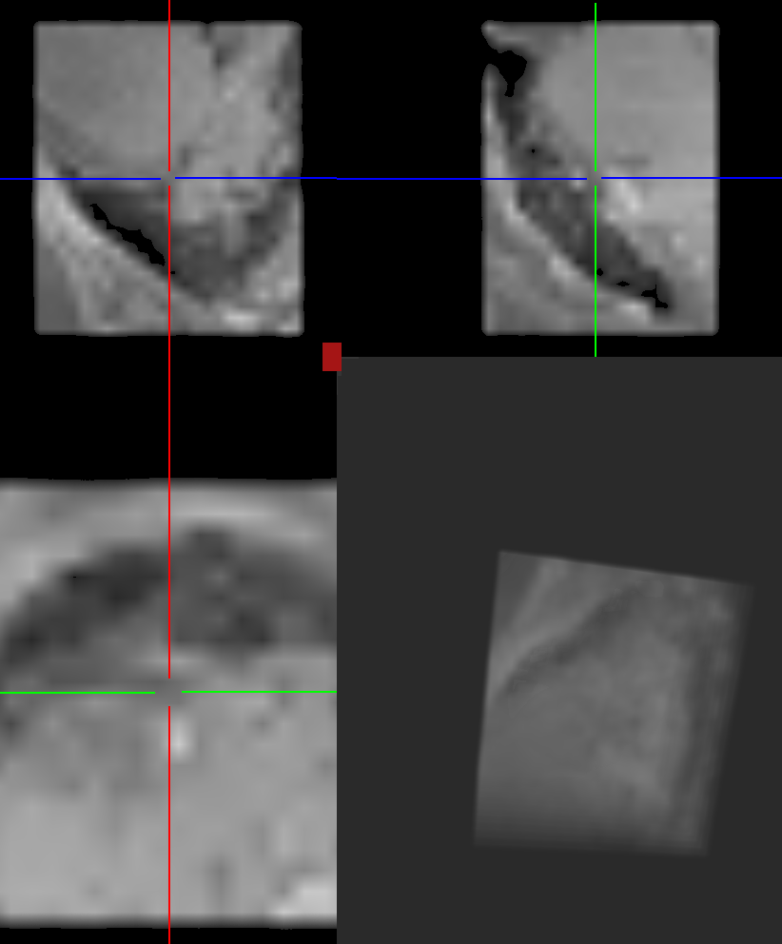
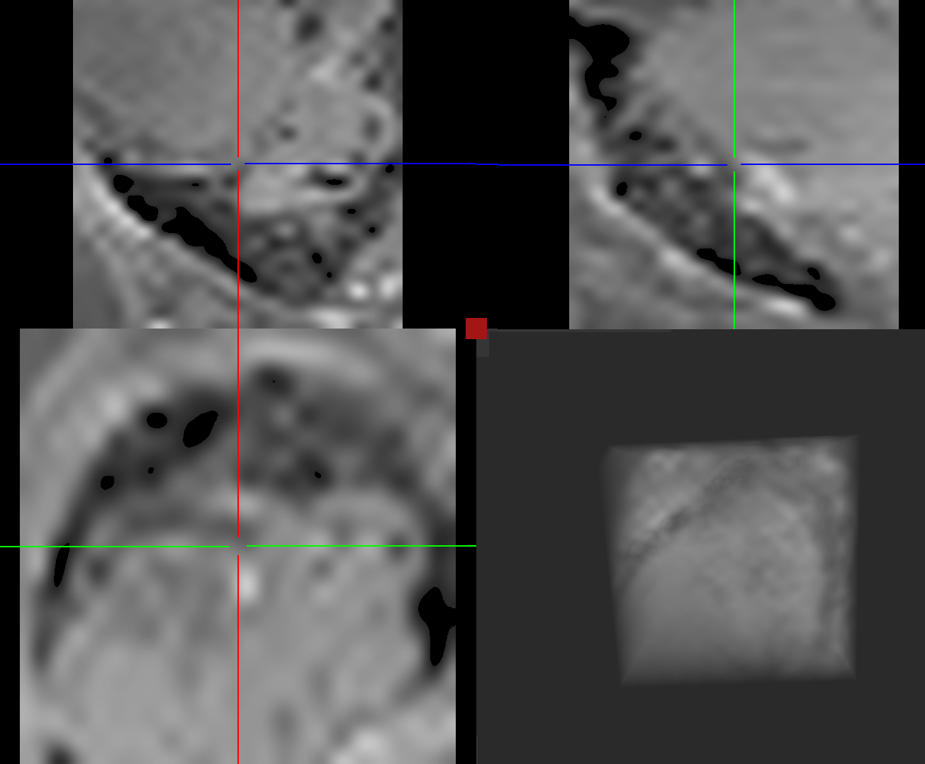
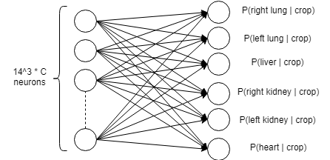
STEP 2
Started writing code for the neural network. This part of presentation will focus on the intuition behind the model.
Classification network (predict whether a proposal is a lung, liver etc)
(W,H,D,C)
(14,14,14,C)
List of proposals
Vectorize
Crop
Resize

Slide 13
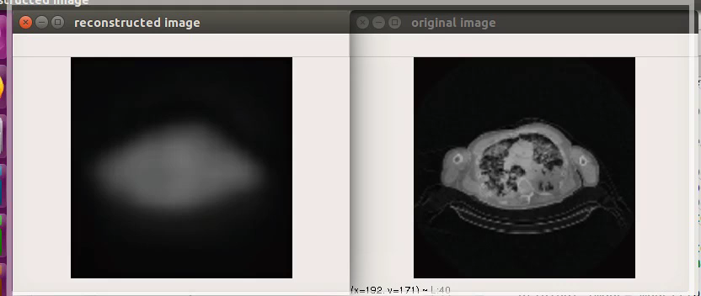
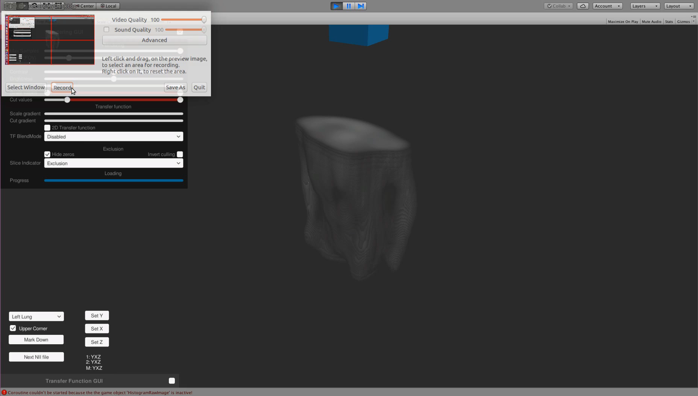
STEP 3
Improve the performance using unsupervised learning. We have 5 labeled examples but 50 unlabeled.
Neural network
3D Input volume
Feature extraction part (encoding)
Region proposal network
Classification network
Feature decoding
Features
Proposals
Final predictions
The compression rate is 30x.

Slide 14
STEP 3
Started writing code for the neural network. This part of presentation will focus on the intuition behind the model.
Neural network
3D Input volume
Feature extraction part
Region proposal network
Classification network
Features
Proposals
Final predictions

Slide 15
RELEVANT WORK
ConvNet-Based Localization of Anatomical Structures in 3D Medical Images
Bob D. de Vos, Jelmer M. Wolterink, Pim A. de Jong, Tim Leiner, Max A. Viergever, Ivana Isgum
They used a less elegant solution to this problem (included some heuristics and feature engineering). They had a larger private dataset, thus I could not compare the my model with theirs.
Automatic organ segmentation on torso CT images by using content-based image retrieval
Xiangrong Zhou, Takeshi Hara, Masayuki Kanematsu, Hiroshi Fujita
No neural networks were used. Still, they used a similar method as above. They also included segmentation as an objective.
VoxelNet: End-to-End Learning for Point Cloud Based 3D Object Detection
Yin Zhou, Oncel Tuzel
Similar method as mine, but they used it for processing Lidar data for autonomous vehicles.
Some of the ideas could be used for future improvement of my method.
Notes:
Talk about your part of innovation.

Slide 16



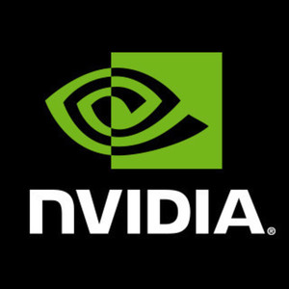
CRAFTING TOOLS
Deep learning frameworks
Programming language
Keras and Tensorflow represent the best combination for rapid prototyping in machine learning.
High-level, general purpose, code readability
C++
Nvidia GPU
Some of the operations needed for 3D processing were not already implemented in the above frameworks.
It is a must have for fast results.

Slide 17
MONETIZING
Research funds would be the best thing ????????????????????????
MRI and CT scanner prices are already high
MRI scanner prices range form 150K $ to 400K $.
CT scanner prices range from 75K $ to 800K $.
The research version of the project should remain open source
This project is based on another open source project
Price of integrating the production model
A simple 2K $ system with a Nvidia GTX 1080 GPU should be sufficient. Production algorithm should be licensed.

Slide 18
THANK YOU!
Any Questions?
Alexandru Iftimie
https://github.com/Iftimie/Mask_RCNN

